Slide 1
Graph traversals: BFS, DFS

Slide 2
Strategies
Traversals of graphs are also called searches
We can use either breadth-first or depth-first traversals
Breadth-first requires a queue
Depth-first requires a stack
We each case, we will have to track which vertices have been visited requiring Θ(|V|) memory
One option is a hash table
If we can use a bit array, this requires only |V|/8 bytes
The time complexity cannot be better than and should not be worse than Θ(|V| + |E|)
Connected graphs simplify this to Θ(|E|)
Worst case: Θ(|V^{|2})

Slide 3
Breadth-first traversal
Consider implementing a breadth-first traversal on a graph:
Choose any vertex, mark it as visited and push it onto queue
While the queue is not empty:
Pop to top vertex v from the queue
For each vertex adjacent to v that has not been visited:
Mark it visited, and
Push it onto the queue
This continues until the queue is empty
Note: if there are no unvisited vertices, the graph is connected

Slide 4
Algorithm\Procedure
Breadth_First_Serach( Graph, X ) // Here, Graph is the graph that we already have and X is the source node
Let Q be the queue Q.enqueue( X ) // Inserting source node X into the queue Mark X node as visited.
While ( Q is not empty ) Y = Q.dequeue( ) // Removing the front node from the queue
Process all the neighbors of Y, For all the neighbors Z of Y If Z is not visited, Q. enqueue( Z ) // Stores Z in Q Mark Z as visited
Follow the below method to implement BFS traversal.
Declare a queue and insert the starting vertex.
Initialize a visited array and mark the starting vertex as visited.
Follow the below process till the queue becomes empty:
Remove the first vertex of the queue.
Mark that vertex as visited.
Insert all the unvisited neighbors of the vertex into the queue.
https://www.geeksforgeeks.org/breadth-first-search-or-bfs-for-a-graph/

Slide 5
Algorithm\Procedure
BFS pseudocode
create a queue Q
mark v as visited and put v into Q
while Q is non-empty
remove the head u of Q
mark and enqueue all (unvisited) neighbors of u

Slide 6
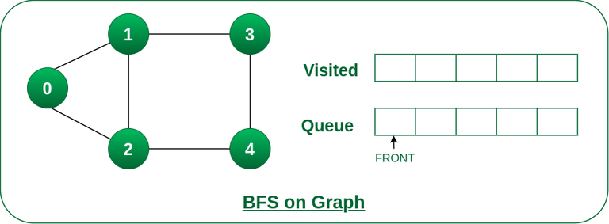
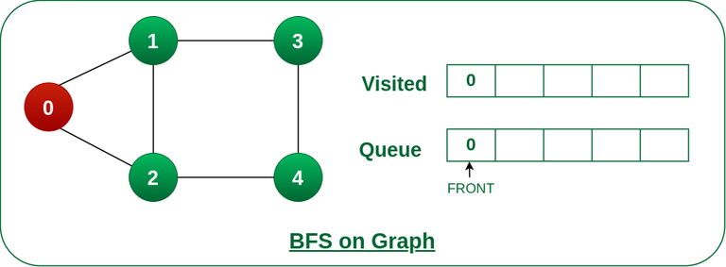
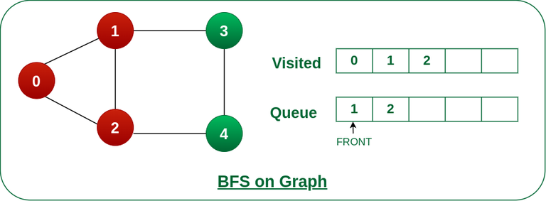
Animation wise- Queue
Step1: Initially queue and visited arrays are empty.
Step2: Push node 0 into queue and mark it visited.
Step 3: Remove node 0 from the front of queue and visit the unvisited neighbors (mark visited) and add them into queue.
https://www.geeksforgeeks.org/breadth-first-search-or-bfs-for-a-graph/

Slide 7
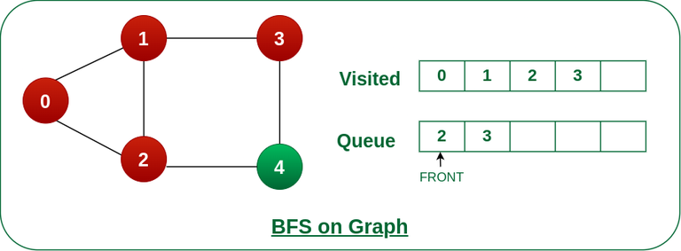
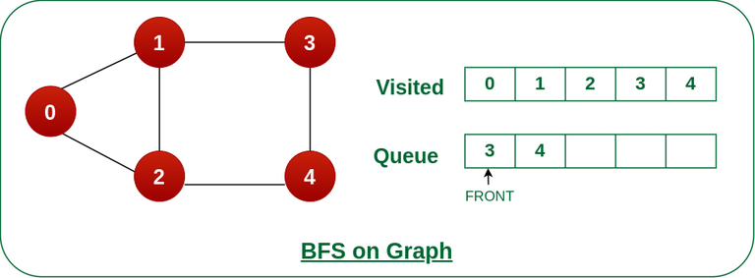

Animation wise- Queue
Step 4: Remove node 1 from the front of queue and visit the unvisited neighbours (mark visited) and add them into queue.
Step 5: Remove node 2 from the front of queue and visit the unvisited neighbours (mark visited) and add them into queue.
Step 6: Remove node 3 from the front of queue and visit the unvisited neighbours (mark visited) and add them into queue. As we can see that every neighbours of node 3 is visited, so move to the next node that are in the front of the queue.
https://www.geeksforgeeks.org/breadth-first-search-or-bfs-for-a-graph/

Slide 8

Animation wise- Queue
Steps 7: Remove node 4 from the front of queue and visit the unvisited neighbours and add them into queue. As we can see that every neighbours of node 4 are visited, so move to the next node that is in the front of the queue.
Time Complexity: O(V+E), where V is the number of nodes and E is the number of edges. Auxiliary Space: O(V)
Now, Queue becomes empty, So, terminate these process of iteration.
https://www.geeksforgeeks.org/breadth-first-search-or-bfs-for-a-graph/

Slide 9
Breadth-first traversal
The size of the queue is O(|V|)
The size depends both on:
The number of edges, and
The out-degree of the vertices

Slide 10
Applications of BFS
Shortest Path and Minimum Spanning Tree for unweighted graph
Peer-to-Peer Networks
Crawlers in Search Engines
Social Networking Websites
GPS Navigation systems
Broadcasting in Network
In Garbage Collection
Cycle detection in the undirected graph: In undirected graphs, either Breadth First Search or Depth First Search can be used to detect cycle. We can use BFS to detect cycle in a directed graph also.
To test if a graph is Bipartite: We can either use Breadth First or Depth First Traversal.
Path Finding
Finding all nodes within one connected component: We can either use Breadth First or Depth First Traversal to find all nodes reachable from a given node.

Slide 11
Depth-first traversal
Consider implementing a depth-first traversal on a graph:
Choose any vertex, mark it as visited
From that vertex:
If there is another adjacent vertex not yet visited, go to it
Otherwise, go back to the most previous vertex that has not yet had all of its adjacent vertices visited and continue from there
Continue until no visited vertices have unvisited adjacent vertices
Two implementations:
Recursive
Iterative

Slide 12
Algorithm\Procedure
DFS Pseudocode (recursive implementation)
The DFS algorithm works as follows:
Start by putting any one of the graph's vertices on top of a stack.
Take the top item of the stack and add it to the visited list.
Create a list of that vertex's adjacent nodes. Add the ones which aren't in the visited list to the top of the stack.
Keep repeating steps 2 and 3 until the stack is empty.
DFS(G, u)
u.visited = true
for each v ∈ G.Adj[u]
if v.visited == false
DFS(G,v)
init() {
For each u ∈ G
u.visited = false
For each u ∈ G
DFS(G, u)
}

Slide 13
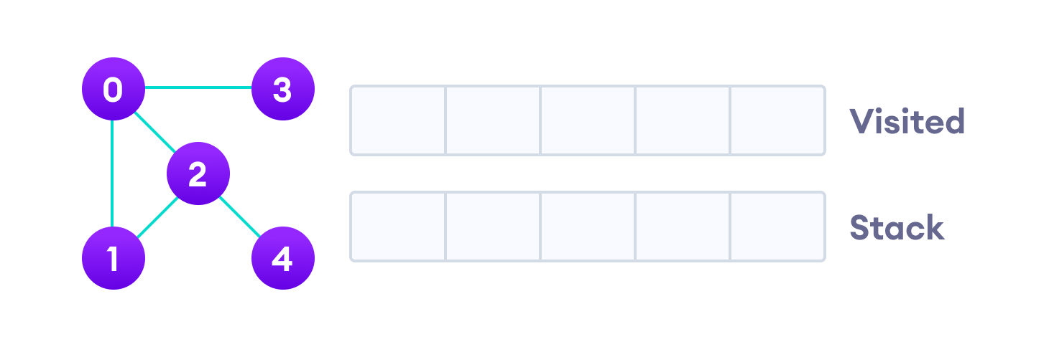
Example- DFS using Stack
Visit the element at the top of stack
Undirected graph with 5 vertices
Vertex 2 has an unvisited adjacent vertex in 4, so we add that to the top of the stack and visit it.
Visit the element and put it in the visited list
Vertex 4 has no unvisited adjacent vertex , so we will back track

Slide 14
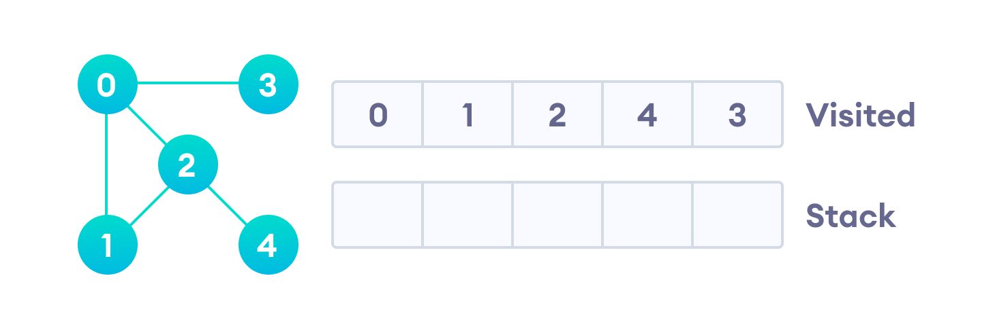
Animation wise- Stack
0 | 1 | 2 | 4 | 3
0
After we visit the last element 3, it doesn't have any unvisited adjacent nodes, so we have completed the Depth First Traversal of the graph.
Complexity of Depth First Search
The time complexity of the DFS algorithm is represented in the form of O(V + E), where V is the number of nodes and E is the number of edges.
The space complexity of the algorithm is O(V).

Slide 15
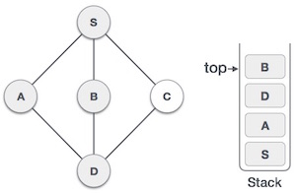
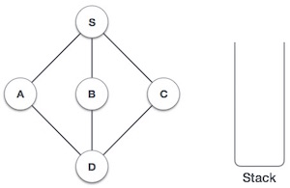
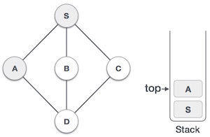
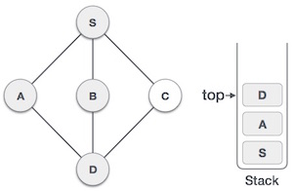
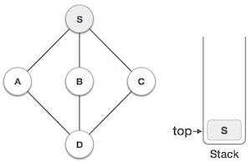
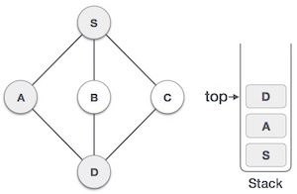
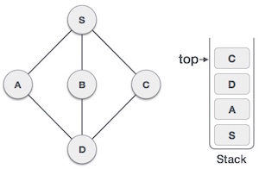
Another example-DFS

Slide 16
Application of DFS Algorithm
To test if the graph is bipartite
For finding the strongly connected components of a graph
For detecting cycles in a graph
DFS on an unweighted graph, will create a minimum spanning tree for all pairs of shortest-path trees.
Cycles present in the graph can be identified using DFS, and also even in BFS if there exists a back edge it means we have a cycle in the given graph.
DFS helps in finding the path between source and destination index in the graph.
Topological sorting, a famous algorithm that is used for job scheduling uses DFS for graph traversal.
Using BFS we can find the number of connected components, using DFS we can find the number of strongly connected components.
Strongly connected components are components in which there is a path from each vertex to every other vertex in the graph.

